Slide 1
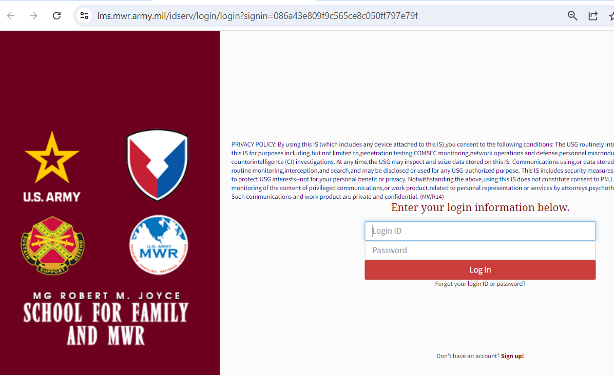
How to retrieve LoginID and Reset Password
Click on “Fortgot your loginID”

Slide 2
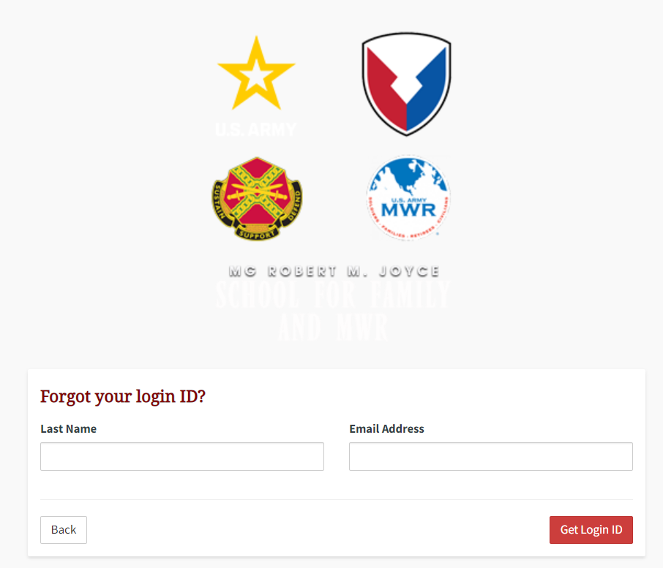
1./Enter your last name here
2./Enter your email here (the email that was associated with your account)
3./Click here when done and check your email for your loginID (make sure to check your spam/junk folder.)

Slide 3
Once you have retrieved your LoginID, please go back to the login page and click on the link: Forgot your Password
Click on “Fortgot your password”

Slide 4
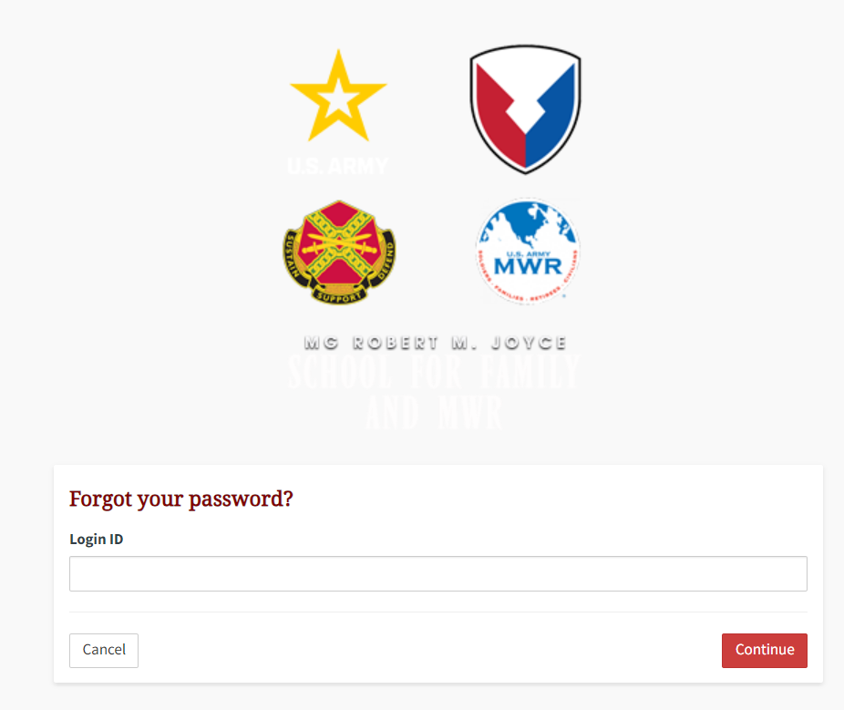
Enter your loginID here and click “Continue”

Slide 5
