Slide 1
Career Program 29 Overview
February 2019

Slide 2
Agenda
Army Civilian Career Programs
Career Program 29
IDP
Career Program Plan
Civilian Training Sources
CP29-funded Training Opportunities
Timeline & Key Dates
FAQs
Questions & Discussion
usarmy.jbsa.imcom-hq.mbx.mycareer29@mail.mil/(210) 466-0956
2

Slide 3
What is a career program?
Career programs (CPs) provide each Army civilian with the capability to define career goals by identifying career development paths and competency-based training plans.
Every Army civilian is assigned to one of the 31 CPs based on their position description (PD).
CPs centrally fund training, education and professional development opportunities for their assigned careerists.
3
usarmy.jbsa.imcom-hq.mbx.mycareer29@mail.mil/(210) 466-0956

Slide 4
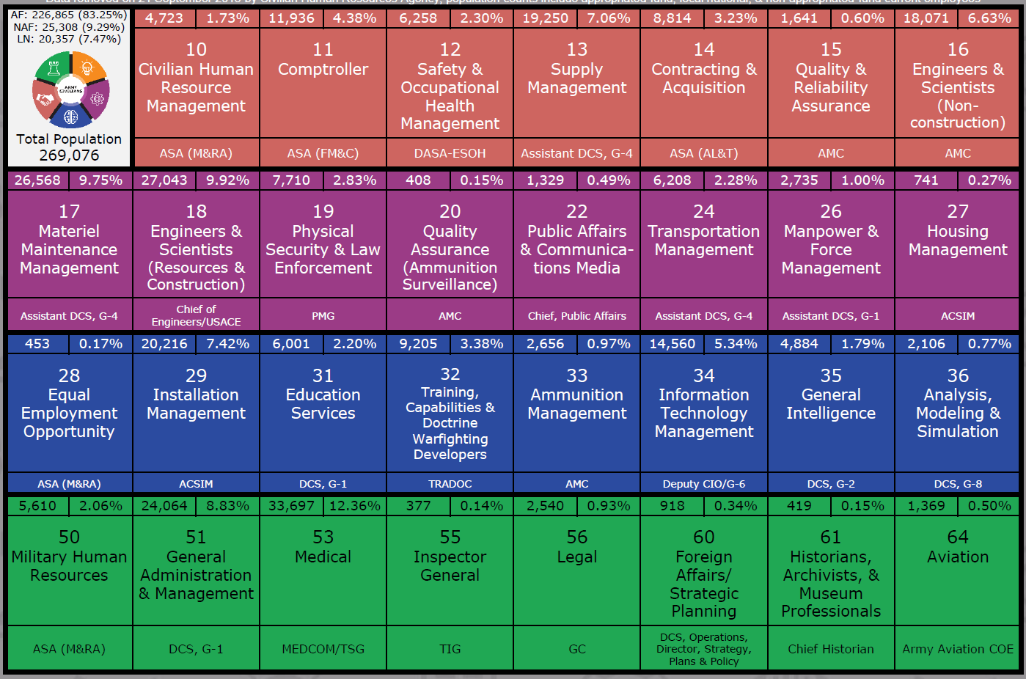
Army Civilian Career Programs (a/o 21 Sep 18)
usarmy.jbsa.imcom-hq.mbx.mycareer29@mail.mil/(210) 466-0956

Slide 5
CP29 Mission & Vision
Mission: The CP29 Proponency Office develops, promotes and executes policy, programs and strategies that enable a diverse, agile and highly competent Installation Management profession to support Total Army readiness.
History
CP29 is one of 8 new career programs established in 2014 by the Civilian Workforce Transformation (CWT) initiative.
The CP29 Proponency Office achieved initial operating capability in April 2014 and full operational capability in September 2014.
Who We Are
The CP29 Proponency Office consists of 6 full-time staff members: 4 San Antonio, 1 Fort Hood, & 1 Pentagon
usarmy.jbsa.imcom-hq.mbx.mycareer29@mail.mil/(210) 466-0956

Slide 6
Who is CP29
Approximately 20,000 careerists within 24 commands/organizations across the Army
GS 02-15 (and equivalents on other pay plans)
Wide variety of occupations at all echelons
Global and worldwide
77% Installation Management Command
6% United States Army Materiel Command
4% United States Army Corps of Engineers
3% United States Army Pacific
usarmy.jbsa.imcom-hq.mbx.mycareer29@mail.mil/(210) 466-0956

Slide 7
CP29 Occupations
The most populous occupational series in CP29 are Education (1701/1702) and Sports & Rec (0188/0189).
usarmy.jbsa.imcom-hq.mbx.mycareer29@mail.mil/(210) 466-0956

Slide 8
CP29 Occupations
CP29 is comprised of 64 occupational series.
Labor & Trade
White Collar
Electrical Installation & Maintenance
General Services & Support Work
Structural & Finishing Work
Metal Work
Painting & Paperhanging
Plumbing & Pipefitting
Printing
Wood Work
General Maintenance & Operations Work
General Equipment Maintenance
Plant & Animal Work
Social Science, Psychology, & Welfare
General Administrative, Clerical, & Office Services
Information & Arts
Business & Industry
Equipment, Facilities, & Services
Education
Miscellaneous Occupations
usarmy.jbsa.imcom-hq.mbx.mycareer29@mail.mil/(210) 466-0956

Slide 9
CP29 in the Garrison
LEGEND
All Personnel
Some Personnel
GC
DGC
CSM
GARRISON MGMT &
CONTROL OFFICES
RES MGMT OFC (RMO)
HHC/
HHD
PLANS, ANALYSIS & INT (PAIO)
ADMIN OFFICE
INFORMATION MGT OFFICE (IMO)
INSTALLATION SUPPORT DIRECTORATES
DHR
Most staff but NOT in Ed services, 0201 series positions
DFMWR
Director,
division chiefs, most of ACS,
majority of staff
DPTMS
Director, OPS Chief,
Plans Chief, OPS and
Plans specialists
and officers
DES
Director & Deputy Director
DPW
Business OPS , Integration Division Chief and staff NOT in environmental or 0800 series positions
INSTALLATION SUPPORT OFFICES
LEGAL
(CLO)
PUBLIC
AFFAIRS
(PAO)
RELIGIOUS
SUPPORT
(RSO)
EQUAL EMP
OPP
(EEO)
SAFETY
(ISO)
INTERNAL
REVIEW
(IRACO)
usarmy.jbsa.imcom-hq.mbx.mycareer29@mail.mil/(210) 466-0956

Slide 10
Civilian Training Sources
CAREER PROGRAM 29
Academic Degree Training
Developmental Assignments
On-site training
Certified Public Manager
City-County Management Senior Fellowship Program
Functional/competency-specific courses
HQDA
Civilian Education System (CES)
Senior Enterprise Talent Management/Enterprise Talent Management (SETM/ETM)
Harvard University Senior Executive Fellows Program
Army Congressional Fellowship Program
Defense Civilian Emerging Leader Program
COMMAND
Functional/competency-specific courses
Supervisor training
Emerging Enterprise Leaders Program (EELP)
Command-specific training, e.g. Garrison Leader’s Course, School of FMWR courses, etc.
Enterprise-wide Critical Skill Gaps
Command requirements
usarmy.jbsa.imcom-hq.mbx.mycareer29@mail.mil/(210) 466-0956

Slide 11
Career Program* Plan
Required by AR 690-950, Career Program Management.
Signed by FCR Ms. Randon in June 2018; currently pending approval at AG1-CP.
Enables a proactive assessment of competencies needed for readiness within the Installation Management community.
Intended as a living document that adapts to both the program’s objectives and its careerists’ requirements.
*Formally referred to as the ACTEDS Plan
usarmy.jbsa.imcom-hq.mbx.mycareer29@mail.mil/(210) 466-0956

Slide 12
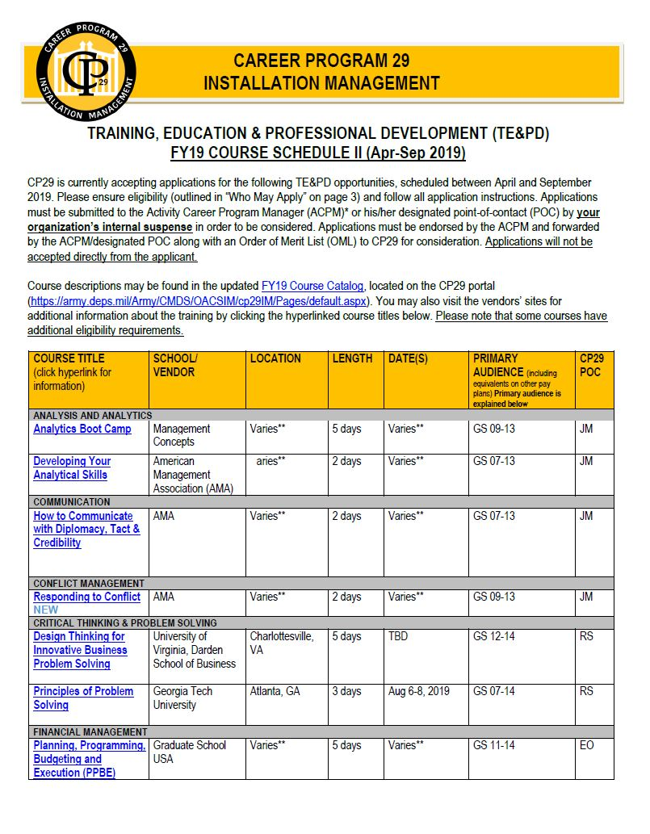
CP29-Funded Training Opportunities
Catalog
New Catalog to be released in Apr
Course Schedule
Schedules published bi-annually Jul (Nov-Mar courses) Nov (Apr-Sep courses)
usarmy.jbsa.imcom-hq.mbx.mycareer29@mail.mil/(210) 466-0956

Slide 13
CP29-Funded Training Opportunities
ACADEMIC DEGREE TRAINING (ADT)
Funding available to GS-09 through GS-15 (and equivalents) for academic degrees from an accredited university.
Applicants must have been accepted to university prior to application.
Must meet Competitive Professional Development eligibility requirements to include serving two years (in any combination) of permanent, full-time Army civilian employment by the nomination deadline (per AR 350-1).
Academic Degree Training (ADT)
Announcement Cycle
ADT announcement | Apr
ADT selection notification | Nov
usarmy.jbsa.imcom-hq.mbx.mycareer29@mail.mil/(210) 466-0956

Slide 14
CP29-Funded Training Opportunities
DEVELOPMENTAL ASSIGNMENT PROGRAM (DAP)
Broadening experience for GS-09 through GS-14 (and equivalents) to close one or more identified competency gaps through a 60-90 day assignment outside the careerist’s organization.
Previous opportunities have included:
Ft Huachuca Plans & Ops
IMCOM HQ G-9
Announcement Cycle
DAP announcement | Aug
DAP selections | Nov
usarmy.jbsa.imcom-hq.mbx.mycareer29@mail.mil/(210) 466-0956

Slide 15
CP29-Funded Training Opportunities
ON-SITE TRAINING
Training provided by approved vendor, upon request, to CP29 careerists (and others on a space-available basis) at their duty location to address organizational competency gaps.
Announcement Cycle
Call/suspense for requests | Nov
On-site training events | Jan-Aug
usarmy.jbsa.imcom-hq.mbx.mycareer29@mail.mil/(210) 466-0956

Slide 16
CP29-Funded Training Opportunities
CITY-COUNTY MANAGEMENT SENIOR FELLOWSHIP PROGRAM
Opportunity for current, former or future Deputies to the Garrison Commander to gain a better understanding of city/county management.
This program is offered in partnership with the International City-County Management Association (ICMA) and includes a week-long visit to a city/county and provides access to numerous ICMA resources.
Announcement Cycle
CMSFP announcement | Apr
CMSFP selections | Nov
usarmy.jbsa.imcom-hq.mbx.mycareer29@mail.mil/(210) 466-0956

Slide 17
CP29 Funded Training Opportunities
Subject Area
Analysis & Analytics
Communication
Conflict Management
Critical Thinking & Problem Solving
Financial Management
Leadership
Program Management
Project Management
Public Service
Strategic Planning
The current course catalog and schedules can be found on the CP29 portal: https://army.deps.mil/Army/CMDS/OACSIM/cp29IM/Pages/default.aspx

Slide 18
CP29-funded TE&PD timeline and process
SELECTION PROCESS
TIMELINE
Training, Education & Prof Dev (TE&PD)
TE&PD announcement | Jul (Nov-Mar) Nov (Apr-Sep)
TE&PD selection notifications | Sep (Nov-Mar) Feb (Apr-Sep)
Academic Degree Training (ADT)/ City County Manager Senior Fellowship (CMSFP)
ADT/CMSFP announcement | Apr
ADT/CMSFP selection notification | Nov
Senior Executive Institute (SEI)
SEI announcement | Nov
SEI selections | Feb
Developmental Assignments (DAP)
DAP announcement | Aug
DAP selections | Nov
On-site training
Call/suspense for requests | Nov
On-site training events | Jan-Aug
CP29 careerist submits application
ACPM receives applications and creates OML
ACPM forwards OML to CP29
CP29 makes selections & notifies ACPM, careerist and careerist’s supervisor
CP29 coordinates with careerist for training registration and travel, if applicable
usarmy.jbsa.imcom-hq.mbx.mycareer29@mail.mil/(210) 466-0956
Notes:
Christina will brief
SEI announce in Nov , selection in Feb-Mar
CMSFP on ADT timeline
Possible change of TE&PD II announcement from Oct

Slide 19
Key Dates
SEPTEMBER
MARCH
Nov-Mar TE&PD selections
(SETM & ETM application period)
Release TE&PD catalog
NOVEMBER
APRIL
Apr-Sep TE&PD announced
SEI announced
Call for on-site training
ADT selections
DAP selections
CMSFP selections
ADT announced
CMSFP announced
JULY
Oct-Mar TE&PD announced
DECEMBER
AUGUST
Apr-Sep TE&PD applications due to ACPM
Apr-Sep TE&PD OMLs due to CP29
Nov-Mar TE&PD applications due to ACPM
Nov-Mar TE&PD OMLs due to CP29
DAP announced
Short-notice/no-travel TE&PD may be announced (if funding permits)
(Harvard SEF application period)
FEBRUARY
Apr-Sep TE&PD selections
SEI selections
usarmy.jbsa.imcom-hq.mbx.mycareer29@mail.mil/(210) 466-0956
Notes:
Christina will brief

Slide 20
Frequently Asked Questions
1. What is my current CP? Log into MyBiz+ (https://compo.dcpds.cpms.osd.mil/) and review the bottom of your Civilian Career Brief. You will see the name of your career program.
2. How do I change my CP? How do I get in CP29?
Your position description determines your career program. If you believe you are assigned to the incorrect CP, address this with your supervisor.
3. Can I apply for CP29 training if I’m not in CP29? CP29 funds training for CP29 careerists. You should contact your CP for opportunities.
4. Who funds CP29 training?
CP29 training is centrally funded by HQDA (Army Civilian Training, Education and Development System (ACTEDS) funds).
5. How do I find the latest information about CP29?
The best way to stay informed is to visit the CP29 portal https://army.deps.mil/Army/CMDS/OACSIM/cp29IM (CAC-required) and follow us on Facebook www.facebook.com/ArmyCP29
usarmy.jbsa.imcom-hq.mbx.mycareer29@mail.mil/(210) 466-0956

Slide 21
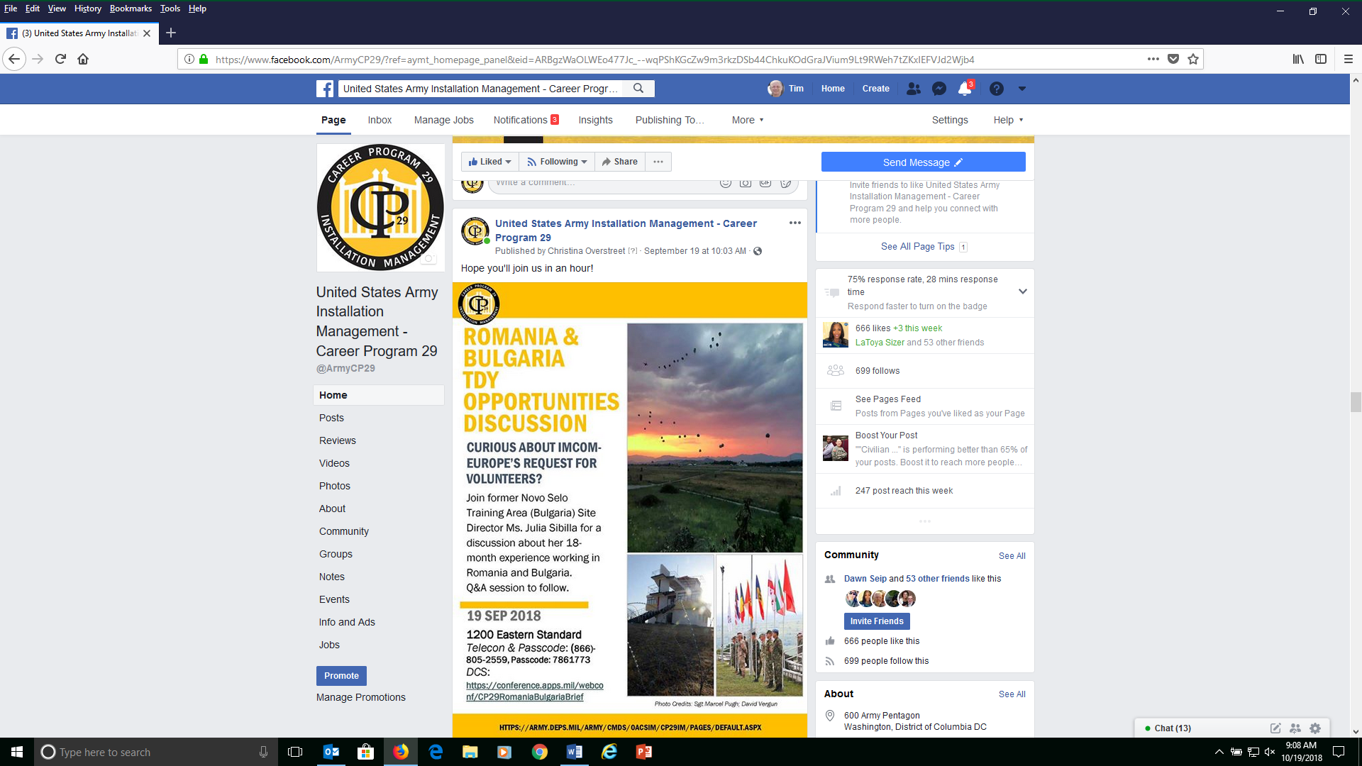
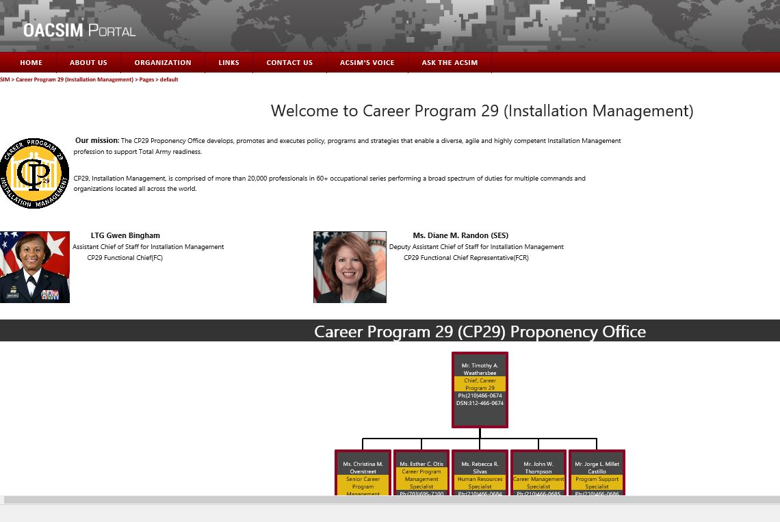
For more information & to stay informed…
www.facebook.com/ArmyCP29
https://army.deps.mil/Army/CMDS/OACSIM/cp29IM (CAC-required)
usarmy.jbsa.imcom-hq.mbx.mycareer29@mail.mil/(210) 466-0956

Slide 22
CP29 Contact Information
CP29 Functional Chief
LTG Gwen Bingham Assistant Chief of Staff for Installation Management (OACSIM)
CP29 Functional Chief Representative
Ms. Diane Randon (SES)
Deputy Assistant Chief of Staff for Installation Management
CP29 group mailbox: usarmy.jbsa.imcom-hq.mbx.mycareer29@mail.mil
CP29 Career Program Manager
Mr. Tim Weathersbee
timothy.a.weathersbee.civ@mail.mil
210-466-0674
Senior Career Program Specialist
Ms. Christina Overstreet
christina.m.overstreet.civ@mail.mil
703-695-7158
Human Resources Specialist
Ms. Rebecca Silvas
rebecca.r.silvas.civ@mail.mil
210-466-0684
Career Program Specialist
Ms. Esther Otis
esther.c.otis.civ@mail.mil
703-695-7100
Career Management Specialist
Mr. John W. Thompson
john.w.thompson29.civ@mail.mil
210-466-0685
Program Support Specialist
Mr. Jorge Millet Castillo
jorge.l.milletcastillo.civ@mail.mil
210-466-0686
usarmy.jbsa.imcom-hq.mbx.mycareer29@mail.mil/(210) 466-0956

Slide 23
BACK-UP SLIDES
usarmy.jbsa.imcom-hq.mbx.mycareer29@mail.mil/(210) 466-0956

Slide 24
CP29 Communications
CP29 Portal | This is a one-stop shop for CP29, where you’ll find news and information, including the current course catalog schedule and newsletter, information about programs, and more! Be sure to bookmark it! | https://army.deps.mil/Army/CMDS/OACSIM/cp29IM/ (CAC-required)
Facebook | Get the latest news and useful information about CP29 and other need-to-know topics | https://www.facebook.com/ArmyCP29
Army Career Tracker | Follow the CP29 Community Page: To follow, log in and go to communities > “communities > civilian > CP29 | http://actnow.army.mil
Newsletter | The CP29 newsletter is published during the first month of each quarter. We are always looking for content and an opportunity to highlight CP29 careerists! | Distributed via email and posted on the CP29 portal
ICE | We want your feedback! | https://ice.disa.mil/index.cfm?fa=card&sp=141311
usarmy.jbsa.imcom-hq.mbx.mycareer29@mail.mil/(210) 466-0956

Slide 25
Individual Development Plan (IDP)
An IDP is a tool to assist employees in career and personal development.
A carefully crafted IDP should help a supervisor and careerist identify required competencies, competency gaps, and a plan to close them.
Army Career Tracker (ACT) is the official repository for Army Civilian IDPs.
The IDP conversation should be ongoing throughout the fiscal year.
A CP29 IDP guide is under development
Pre-Planning
Employee-Supervisor Dialog
Prepare
Implement & Refine
Evaluate Outcomes
IDP Cycle
usarmy.jbsa.imcom-hq.mbx.mycareer29@mail.mil/(210) 466-0956

Slide 26
Army Career Tracker & GoArmyEd
Employee and supervisor must have active Army Career Tracker (ACT) accounts
To create an account: https://actnow.army.mil
Current supervisor must have a supervisor account in ACT
For assistance with ACT, you must submit a help desk ticket
Employee and supervisor must have active GoArmyEd (GAE) accounts
To create an account: https://www.goarmyed.com/
Current supervisor must have a supervisor account in GAE
For assistance with GAE contact the help desk at 1-800-817-9990
usarmy.jbsa.imcom-hq.mbx.mycareer29@mail.mil/(210) 466-0956

Slide 27
Civilian Education System (CES)
CES is the Army’s leader development program for all Army Civilians.
Managed by the Army Management Staff College (AMSC)
Centrally funded for permanent Army Civilians (AF, NAF, LN, WG)
Information and applications at: https://usacac.army.mil/organizations/cace/amsc/courses
CES courses are targeted at the Army Civilian GS grade levels and equivalent pay bands/scales as follows:
Foundation Course | GS-01 through GS-15 new hires
Basic Course | GS-1 through GS-09
Intermediate Course | GS-10 through GS-12
Advanced Course | GS-13 through GS-15
Continuing Education for Senior Leaders | GS-14 through GS-15
usarmy.jbsa.imcom-hq.mbx.mycareer29@mail.mil/(210) 466-0956

Slide 28
SETM/ETM Programs
Multiple modules – see “SETM/ETM Application Presentation” in “New Users” section of SETM webpage at: https://www.csldo.army.mil//
Application window 1 Mar - 15 May each year
Career Program Functional Chief Representative role
ACOM/DRU leadership role
Army-level selection and notification processes
usarmy.jbsa.imcom-hq.mbx.mycareer29@mail.mil/(210) 466-0956

Slide 29
Other DoD and Army-wide opportunities
Army Congressional Fellowship Program:
Eligibility: GS 11-14
References: AR 350-1, AR 1-202
Defense Civilian Emerging Leader Program:
Eligibility: GS 14-15
https://asc.army.mil/web/career-development/programs/dcelp/
Harvard University Program for Senior Executive Fellows
Eligibility: GS 14-15
https://www.hks.harvard.edu/educational-programs/executive-education/senior-executive-fellows
Check with your organization for application windows
usarmy.jbsa.imcom-hq.mbx.mycareer29@mail.mil/(210) 466-0956

Slide 30
Example #1 CP 29 Career
Child Protection Enforcement – Municipal
Civilian Workforce
Bachelors Degree
1993
Masters Degree (MPA)
GS-0101-09
FAPM/EFMP Manager 0CONUS Small (2 yrs)
GS-0101-11
ACS Officer
OCONUS Small (3 yrs)
GS-0340-13
Executive Officer
OCONUS (3 yrs)
GS-0301-13
Director FMWR
OCONUS (2 yrs)
SBLM
GS-0301-12
Deputy DFMWR OCONUS (1 yr)
GS-0101-11
ACS Officer
OCONUS Med (1 yr)
GS-0340-14/
Executive Officer/Deputy GC
CONUS (3 yrs)
NSPS YC-03
Deputy Garrison Commander
CONUS (2 yrs)
US Army
War College Masters
(1 yr)
GS-0340-15
Deputy Garrison Commander (Med)
CONUS (3 yrs)
GS-0340-15
Deputy Garrison Commander (LG)
CONUS (Current)
Additional Professional Development
80 hour Mediation Course
Lean Six Sigma Executive level course
usarmy.jbsa.imcom-hq.mbx.mycareer29@mail.mil/(210) 466-0956
Notes:
Let’s talk a little about career paths and professional growth. While not every one aspires to be a Deputy to a Garrison Commander, a garrison manager or a MOT installation manager, using some examples of the career paths of a couple of our DGCs can provide some insight to professional development. Senior leadership recognition of talent and action. XO position. CYSS to DPTMS.

Slide 31
Example #2 CP 29 Career
Bachelors Degree
Entry level Management Positions in Private Industry
GS-2005 GS 4/5
Supply Clerk Typist
Military spouse
OCONUS (1 yr)
GS-0301 GS 5/7
Records Manager
Air Force
OCONUS (3 yrs)
GS-0301-07
Admin Officer
OCONUS (1 yr)
SBLM
GS-0343-11/12
Quality Mgt Specialist
OCONUS (2 yrs)
MBA Degree
GS-0343-5/7/9
DA Intern
OCONUS (2 yrs)
GS-0301-09
Quality Mgt Specialist OCONUS (2 yrs)
GS-0560-9/11
Budget Analyst
(10 mo.)
COCOM
GS-0343-12
Program Analyst
(2 mo.)
Joint IA Task Force
GS-0343-13
Sr Program Analyst
(1 yrs)
Joint IA Task Force
GS-0346-13
Ch, Logistic Plans & Ops
(4.5 yrs)
Joint IA Task Force
GS-0346-14
Deputy J4, HQ CMDT & Contracting
(1 yrs)
Joint IA Task Force
GS-0301-15
Chief Strategic Communications, IMCOM HQ
(1.5 yrs)
GS-0301-15
Chief Future Plans, IMCOM HQ
(0.5 yr)
Senior Service College
ICAF
1 yr
GS-0346-15
Director J4 & HQ CMDT & Contracting
(4.5 yrs)
Joint IA Task Force
GS-0340-15
Deputy Garrison Commander (LG)
OCONUS (Current)
Additional Professional Development – Private Industry
Ran a Home School High School 16 students
Real Estate License
Additional Professional Development
DA Army Performance Improvement Evaluator 2 yrs and Quality Mgt and Army Performance Improvement Criteria Trainer
LEAD, LEAD Train-the-The Trainer, OLE, PME I
Keys to Success
Experience at different command echelons and in multiple diverse career fields.
Steady progression within organizations
Used IDP to ensure I received critical TNG.
Notes:
Can move in and out of CPs. CPs based on PD, not the individual.

Slide 32
Broadening Opportunities
Soto Cano, Honduras
Bulgaria and Romania
18-month, unaccompanied tours
may include Living Quarters Allowance, Separate Maintenance Allowance, and 25% bonus
For more information: usarmy.mkac.id-europe.mbx.resumes@mail.mil.
Local developmental assignments
usarmy.jbsa.imcom-hq.mbx.mycareer29@mail.mil/(210) 466-0956

Slide 33
Free Opportunities CP29 Promotes
Army E-Learning/ ArmySkill Port (courses and books)
Defense Equal Opportunity Management Institute
Civilian Human Resources Agency
Coursera and edX
Resources through AKO (courses and books)
Resume training
Local developmental assignments
usarmy.jbsa.imcom-hq.mbx.mycareer29@mail.mil/(210) 466-0956

