Slide 1
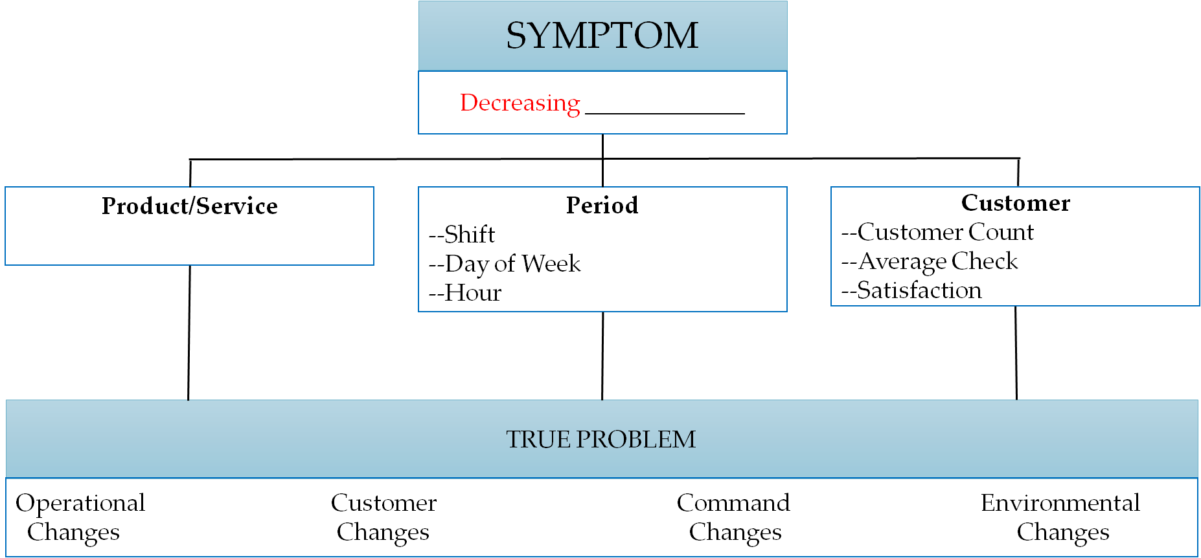
Diagnostic Tools: Root Cause Analysis
Sales
Notes:
The activity we did right before break began our look at cause and effect. This slide is a tool to help diagnose your

Slide 2
TRUE PROBLEM – ______________________________________________________________
Operational Changes | Customer Changes | Command Changes | Environmental Changes
Notes:
We have decreasing sales.

