Slide 1
How to share course management links in DCO II
Login to
www.dcocloud.org

Slide 2
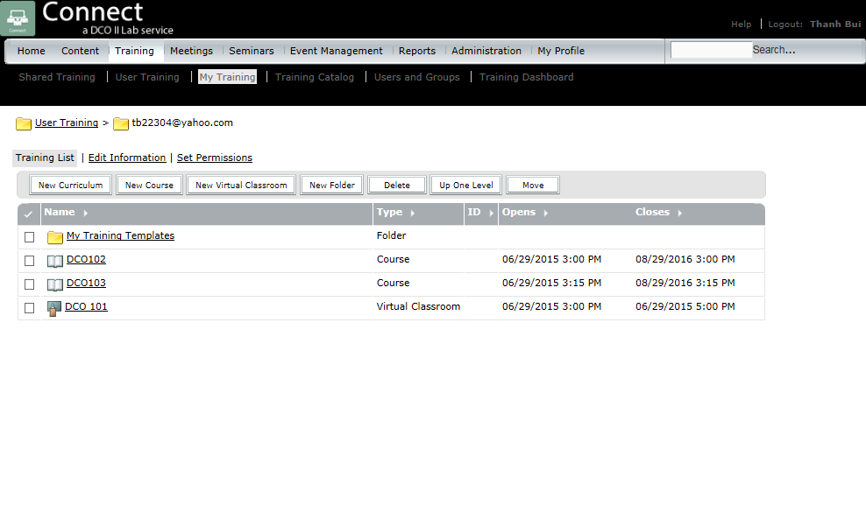
Go to your courses

Slide 3
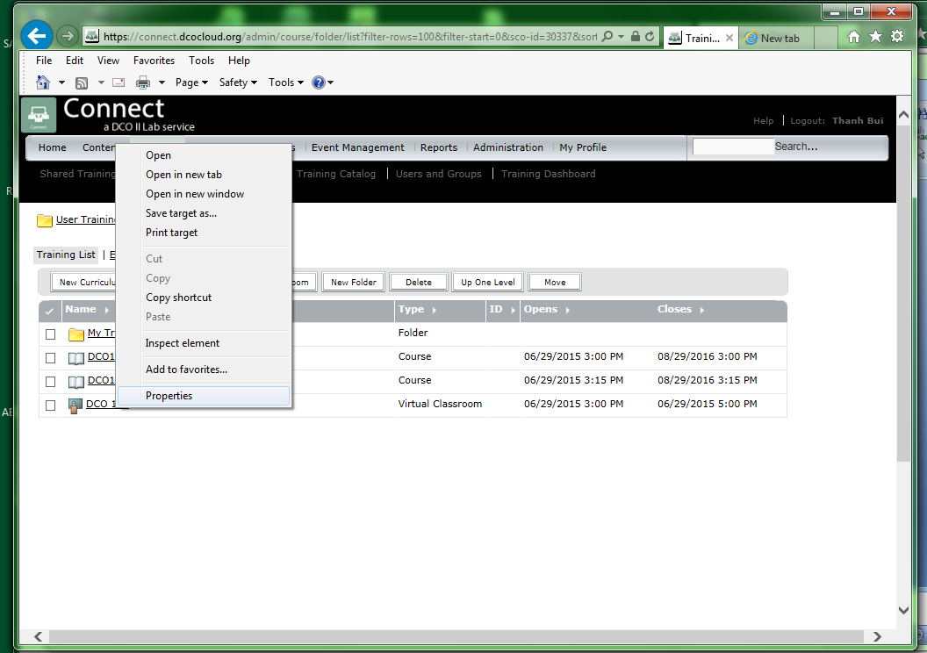
Right Click on the course title to copy shortcut, then paste it to your email to your email.

Slide 4
Click on Set permissions , then find and add all staff members to your list, including all duplicates

