Slide 1
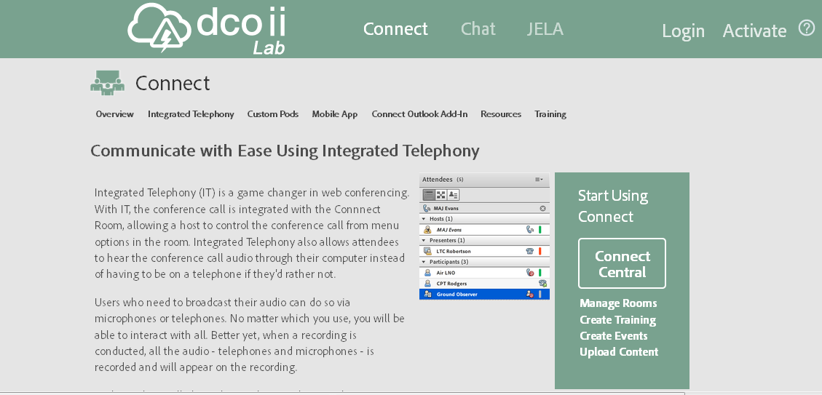
https://www.dcocloud.orgGo
Click here to activate your account

Slide 2
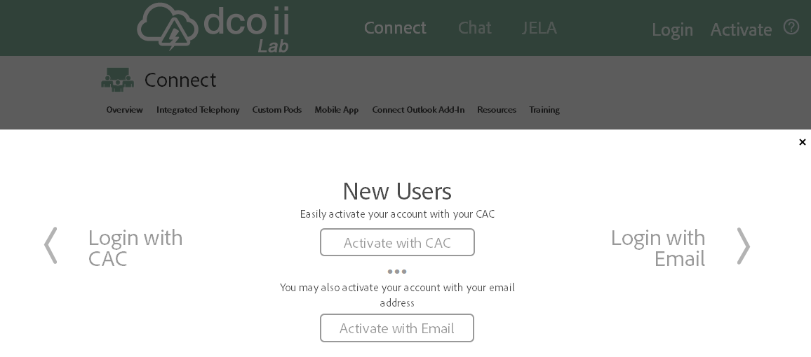
Select this option

Slide 3
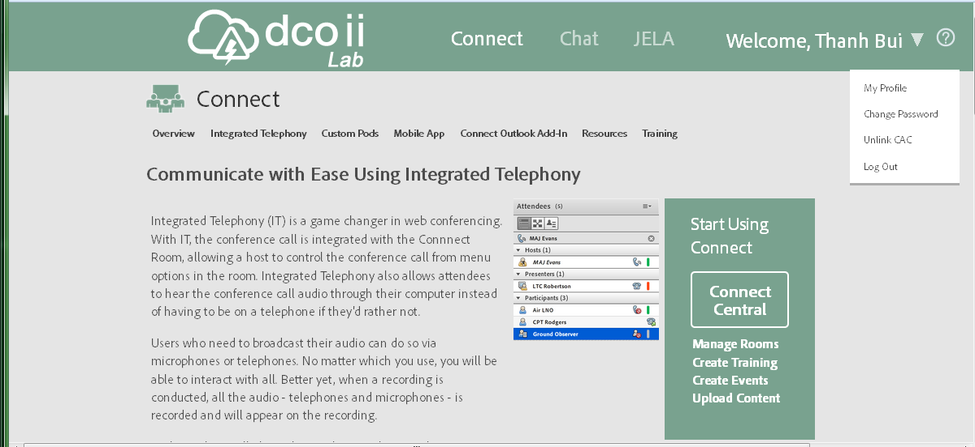
Click on this arrow to see the dropdown and select “Link CAC” and follow the instruction to link your CAC . If your browser is spinning and does not seem to respond when you try to link your CAC, you may want to try on a different browser (Firefox, Chrome etc.) or even on a personal computer.
Your CAC login is optional, so if you can’t link your CAC, you can still use DCOII.
Pw change
Link/Unlink CAC
Click on “Connect Central” to start using DCO II

Slide 4
DCO II help line:
Aaron Wolf
PH: 703-889-9781 or aaron.w.wolf@carahsoft.com

