Slide 1
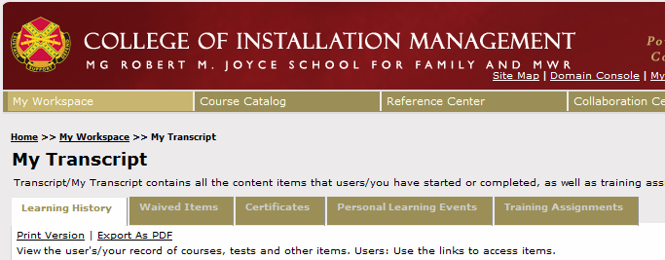
How to Access Course Transcript Details
For Blended Courses
Roll over “My Workspace” and select “My Transcript”

Slide 2
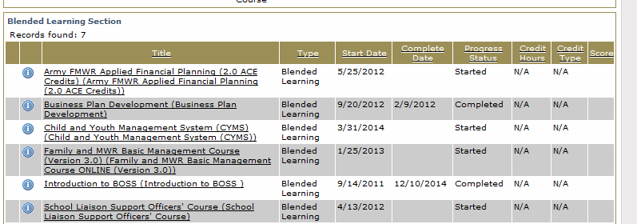
How to Access Course Transcript Details
For Blended Courses
Click on the course you want to view details

Slide 3
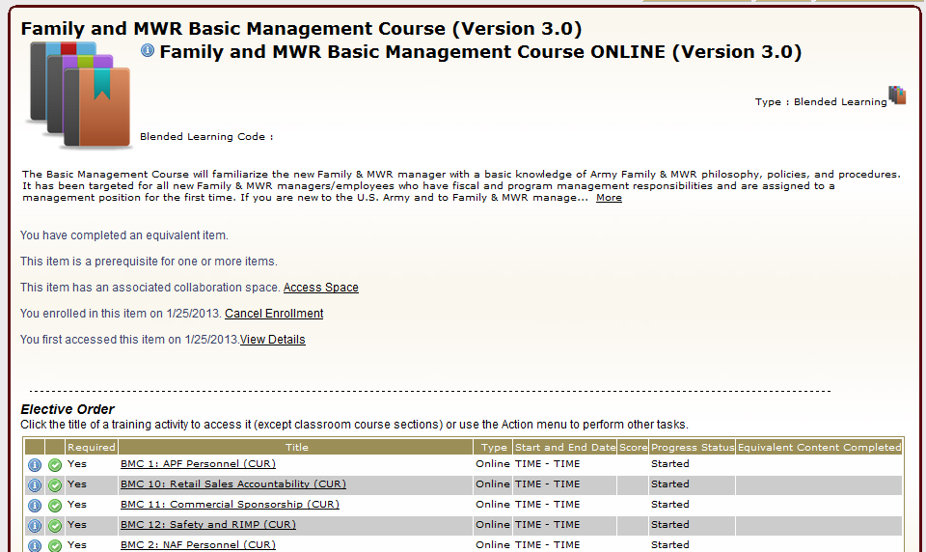
How to Access Course Transcript Details
For Blended Courses
Click on the module you want to view details

Slide 4
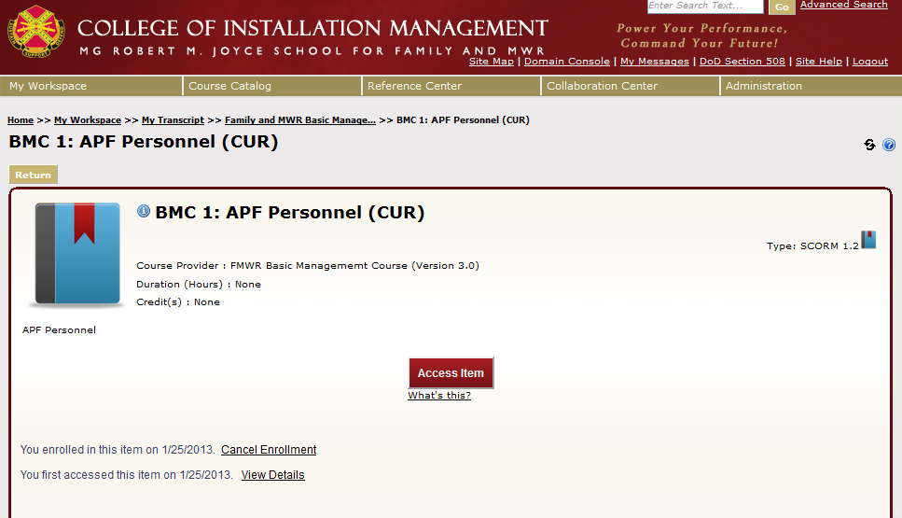
How to Access Course Transcript Details
For Blended Courses
Click on “View Details”

Slide 5
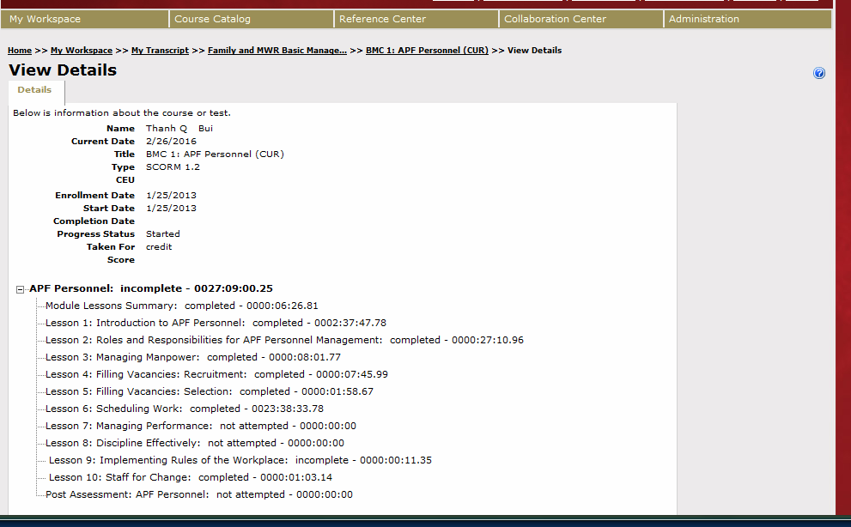
How to Access Course Transcript Details
For Blended Courses
Take a screenshot of this page and send to the School for Family and MWR staff for assistance

